Slide 1
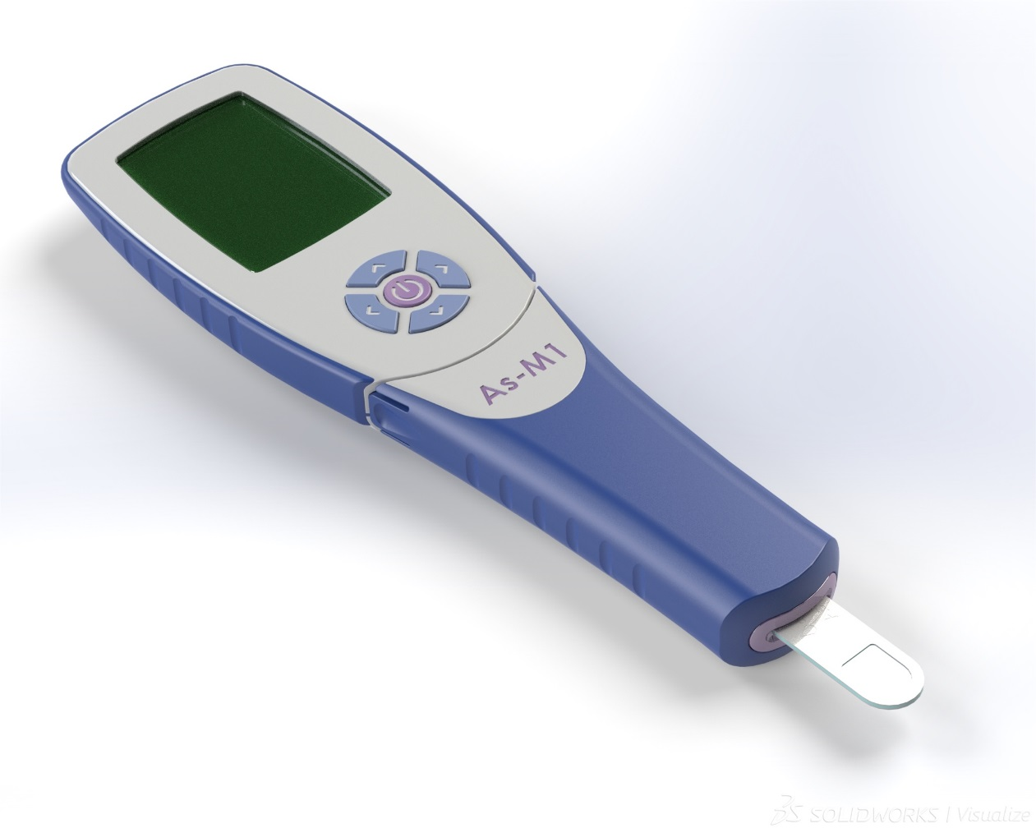
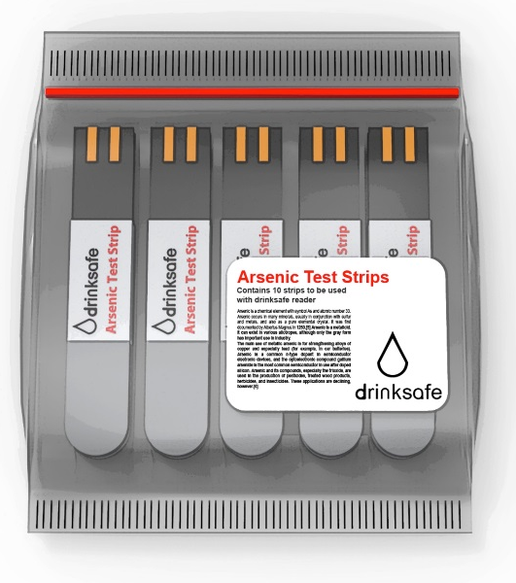
AquAffirmTM Project
Reusable Digital Reader
Disposable Test Strip
Disposable Test Strip
Notes:
Health care consumer testing

